Slide 1
웹 푸시 구현
26th UPnL Workshop
김재찬

Slide 2
Push?

Slide 3
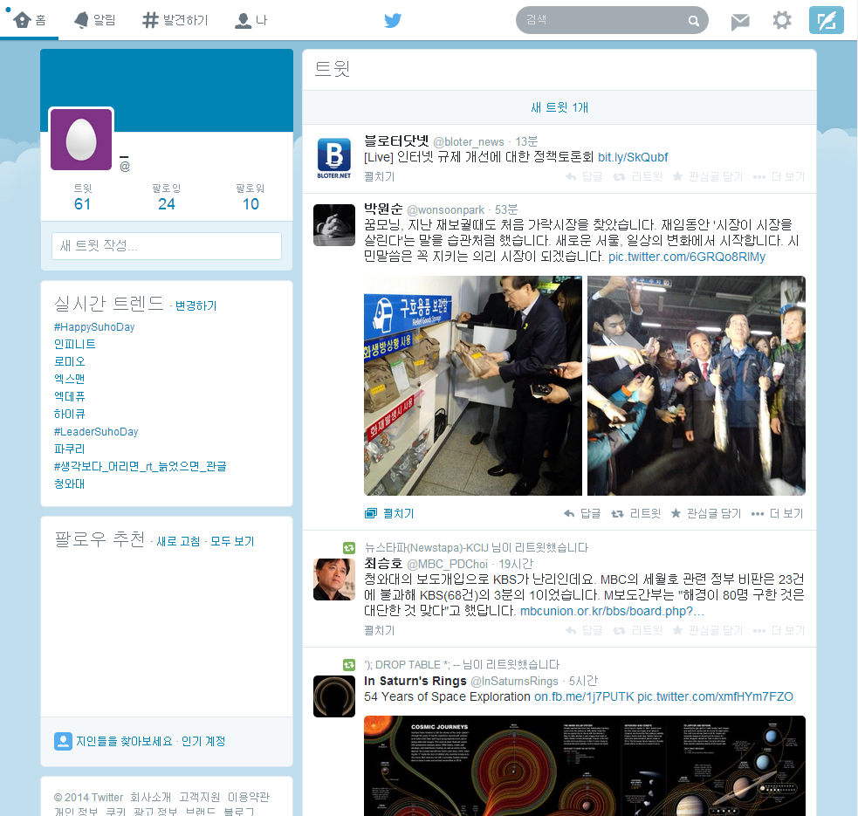

Slide 5
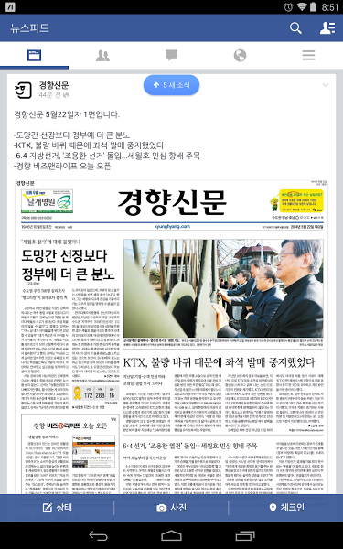

Slide 7
Why?

Slide 8
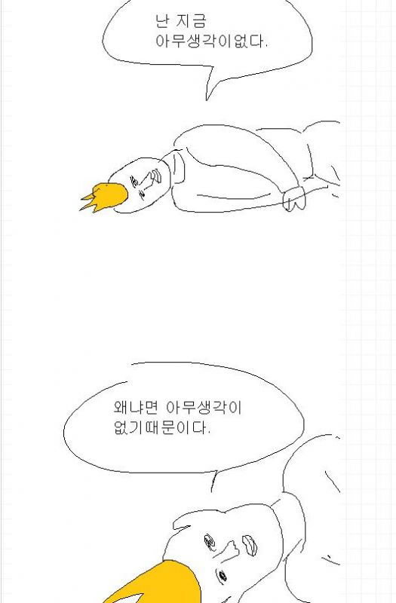

Slide 9
HTTP(1996~)

Slide 10
Web Browser
Server
Database
User

Slide 11
Web Browser
Server
Database
User

Slide 12
Web Browser
Server
Database
User

Slide 13
Web Browser
Server
Database
User

Slide 14
Web Browser
Server
Database
User

Slide 15
Web Browser
Server
Database
User

Slide 16
Push(200x~)

Slide 17
Web Browser1
Server
Database
/write
User1

Slide 18
Web Browser1
Server
Database
/write
User1

Slide 19
Web Browser1
Server
Database
/write
User1

Slide 20
Web Browser1
Server
Database
/write
User1

Slide 21
Web Browser1
Server
Database
/write
User1
Web Browser2
User2

Slide 22
Web Browser1
Server
Database
/write
User1
Web Browser2
User2

Slide 23
Web Browser1
Server
Database
/write
User1
Web Browser2
User2
User1 wrote
something!

Slide 24
Web Browser
Server

Slide 25
Web Browser

Slide 26
Short Polling

Slide 27
Web Browser
Server
Database
User

Slide 28
Web Browser
Server
Database
User
Do this per 30 seconds

Slide 29
Web Browser
Server
Timeline
Timeline

Slide 30
Web Browser
Server
Timeline
Timeline

Slide 31
Web Browser
Server
No new article
Timeline
Timeline

Slide 32
Web Browser
Server
New article
No new article
Timeline
Timeline

Slide 33
Web Browser
Server
New article
No new article
Timeline
Timeline

Slide 34
Web Browser
Server
New article
No new article
1 new article
Timeline
Timeline

Slide 35
Web Browser
Server
New article
No new article
1 new article
New article
Timeline
Timeline

Slide 36
Web Browser
Server
New article
No new article
1 new article
New article
New article
Timeline
Timeline

Slide 37
Web Browser
Server
New article
No new article
1 new article
New article
New article
Timeline
Timeline

Slide 38
Web Browser
Server
New article
No new article
1 new article
New article
New article
2 new article
Timeline
Timeline

Slide 39
Web Browser
Server
New article
No new article
1 new article
New article
New article
2 new article
Timeline
Timeline

Slide 40
Web Browser
Server
New article
No new article
1 new article
New article
New article
2 new article
No new article
Timeline
Timeline

Slide 41
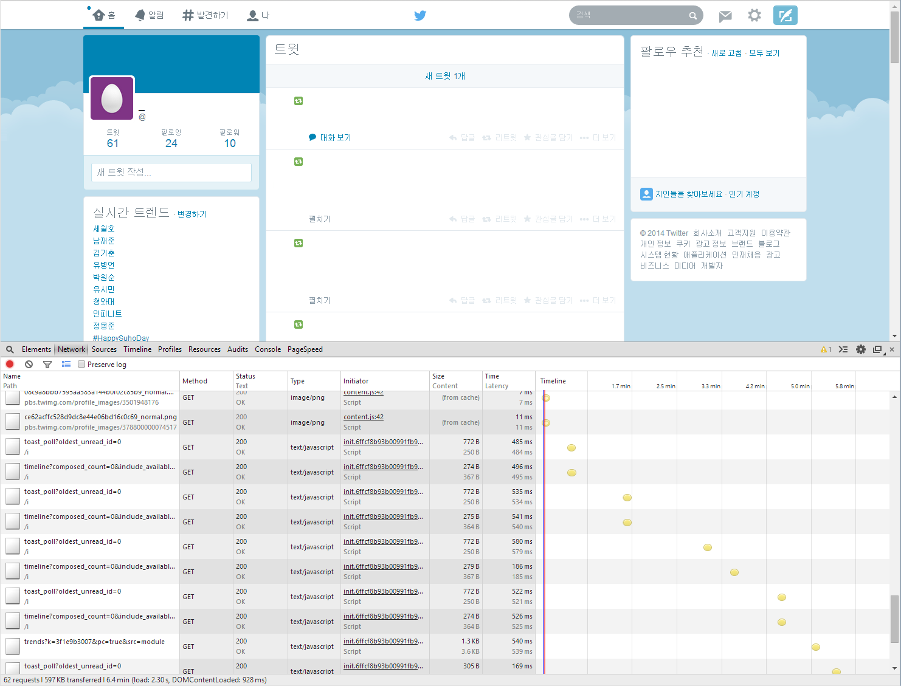

Slide 43
(function(){
var lastArticleId = 0;
setInterval(function(){
$.ajax({
url: 'some_url',
type: 'get',
data: {'last_article_id': lastArticleId}
})
.then(function(data){
data = JSON.parse(data);
if(data.new_articles.length > 0){
// DO SOMETHING
lastArticleId = data.new_articles[0].id;
}
});
}, 30000); })();

Slide 44
Long Polling

Slide 45
Web Browser1
Server
Database
User1

Slide 46
Web Browser1
Server
Database
User1
Web Browser2
/write
User2

Slide 47
Web Browser1
Server
Database
User1
Web Browser2
/write
User2

Slide 48
Web Browser1
Server
Database
User1
Web Browser2
/write
User2

Slide 49
Web Browser1
Server
Database
User1
Web Browser2
/write
User2

Slide 50
Web Browser1
Server
Database
User1
User2 wrote
something!
Web Browser2
/write
User2

Slide 51
Web Browser
Server
Timeline
Timeline

Slide 52
Web Browser
Server
Timeline
Timeline

Slide 53
Web Browser
Server
New article
Timeline
Timeline

Slide 54
Web Browser
Server
new Article!
New article
Timeline
Timeline

Slide 55
Web Browser
Server
new Article!
New article
Timeline
Timeline

Slide 56
Web Browser
Server
new Article!
New article
New article
Timeline
Timeline

Slide 57
Web Browser
Server
new Article!
New article
new article!
New article
Timeline
Timeline

Slide 58
Web Browser
Server
new Article!
New article
new article!
New article
Timeline
Timeline

Slide 59
Web Browser
Server
new Article!
New article
new article!
New article
Connection Timeout
Timeline
Timeline

Slide 60
Web Browser
Server
new Article!
New article
new article!
New article
Connection Timeout
Timeline
Timeline

Slide 61
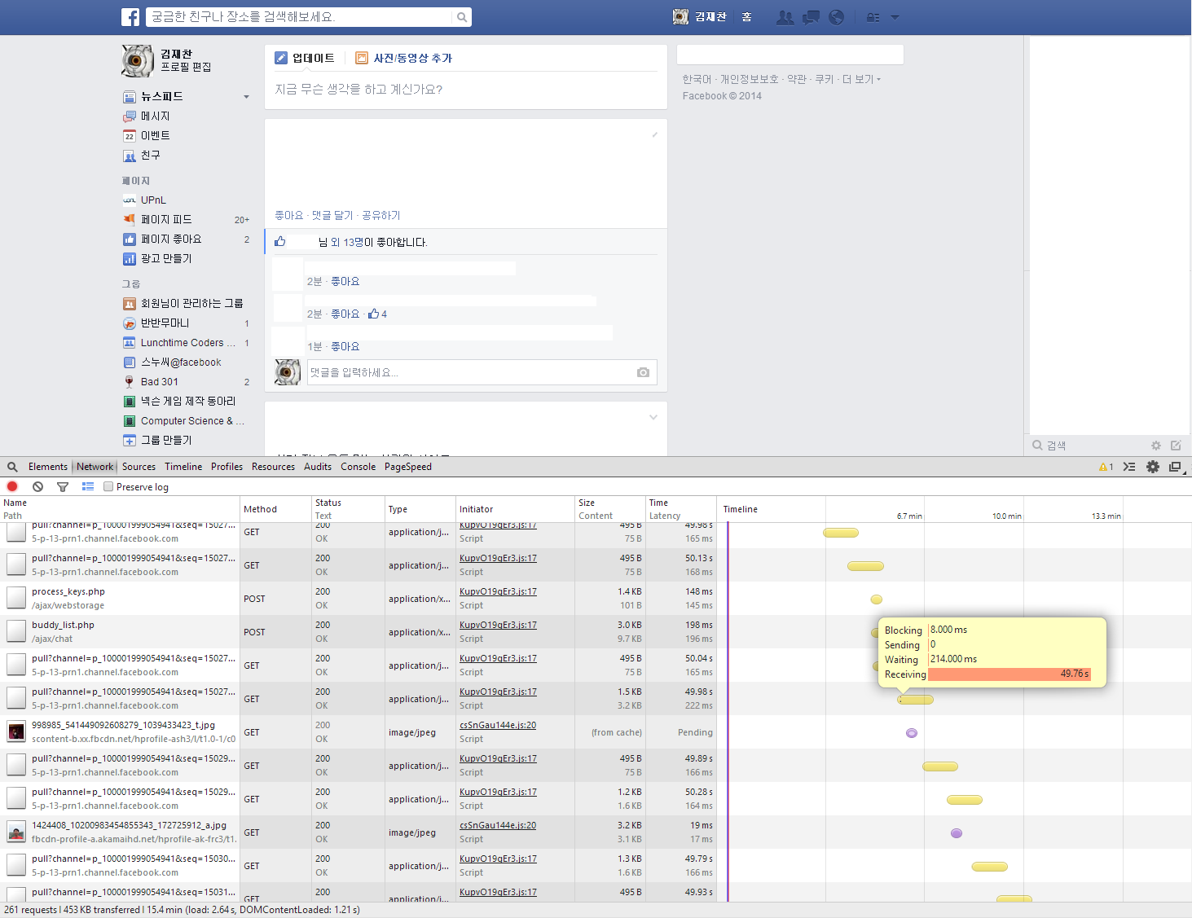

Slide 63
(function(){
var callback = function(data){
data = JSON.parse(data);
// DO SOMETHING
};
var polling_func = function(){
$.ajax({
url: 'some_url',
type: 'get', }
).then(callback)
.always(polling_func);
};
polling_func();
})();

Slide 64
iframe
stream
script tag
xhr

Slide 65
COMET

Slide 66
COMET
Real time push via HTTP request

Slide 67
WebSocket

Slide 68
WebSocket
WebSocket is a protocol providing full-duplex communications channels over a single TCP connection. The WebSocket protocol was standardized by the IETF as RFC 6455 in 2011, and the WebSocket API in Web IDL is being standardized by the W3C.
http://en.wikipedia.org/wiki/WebSocket

Slide 69
(function(){
var ws = new WebSocket('ws://some_url');
ws.addEventListener('message', function(e){
// DO SOMETHING
});
})();

Slide 70
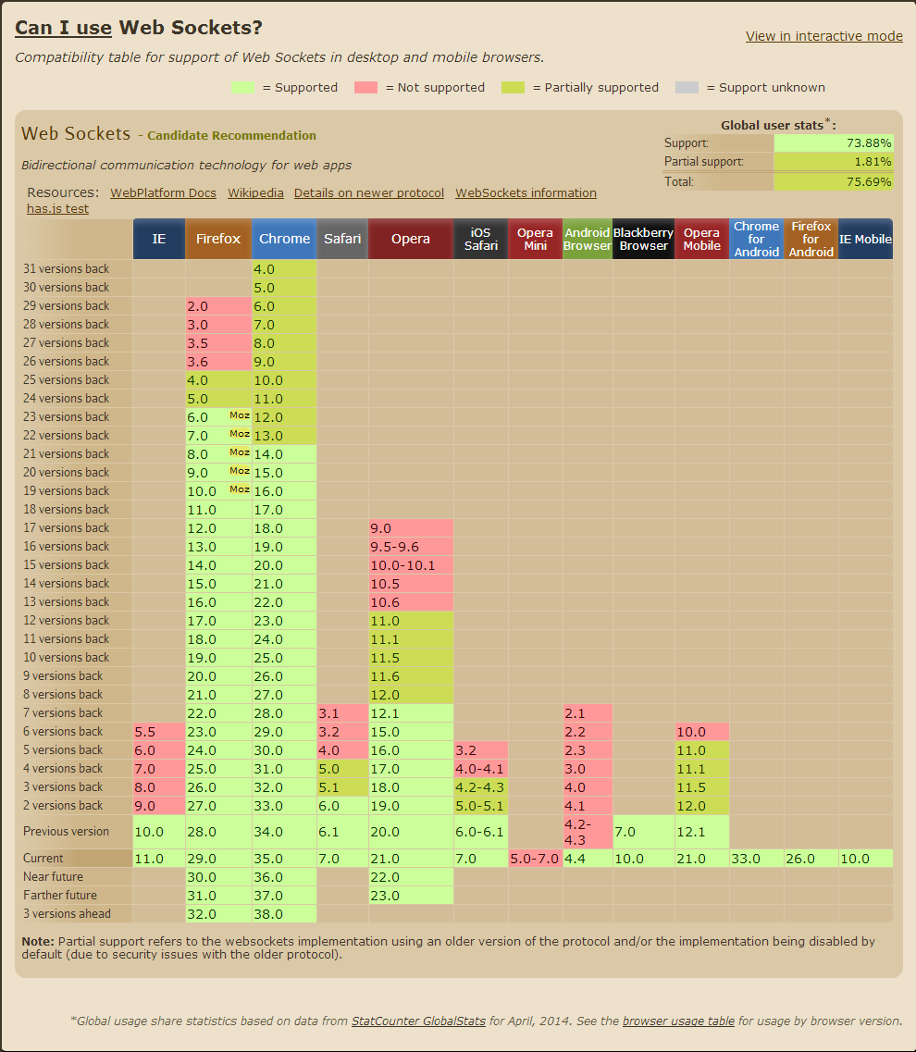
http://caniuse.com/websockets

Slide 71
http://caniuse.com/websockets

Slide 72
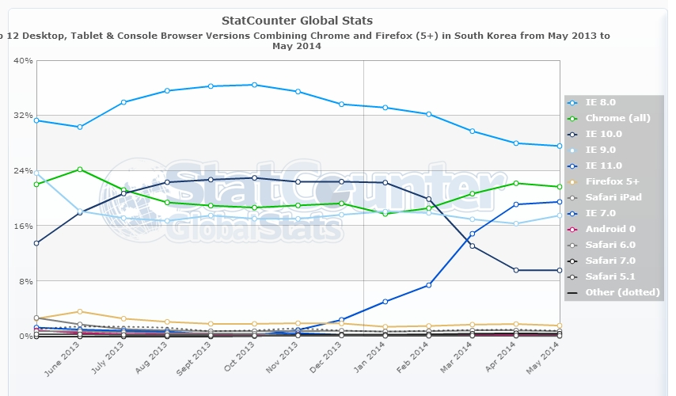

Slide 74
Web Browser
Server

Slide 75
Server

Slide 76
For Short Polling

Slide 77
<?php
$last_article_id = $_GET['last_article_id'];
$queries = mysql_fetch_array("SELECT * FROM article \
WHERE id > " . $last_article_id . "ORDER BY id \
DESC");
$result = make_result($queries);
header('Content-Type: application/json');
echo json_encode($result);

Slide 78
For Long Polling

Slide 79
Web Browser1
Server
Database
/write
User1
Web Browser2
User2

Slide 80
Web Browser1
Server
Database
/write
User1
Web Browser2
User2
???

Slide 81
Web Browser1
Server
Session 1
Database
/write
User1
Web Browser2
Server
Session 2
User2
???

Slide 82
<?php
// get last article id
$last_article = mysql_query("SELECT * FROM article \
ORDER BY id DESC LIMIT 1");
$last_article_id = $last_article['id'];
while(TRUE){
$queries = mysql_fetch_array("SELECT * FROM article\
WHERE id > " . $last_article_id . " ORDER BY id DESC");
if(count($query) > 0){
$result = make_result($query);
header('Content-Type: application/json');
echo json_encode($result);
break;
}
sleep(1);
}

Slide 83
<?php
// get last article id
$last_article = mysql_query("SELECT * FROM article \
ORDER BY id DESC LIMIT 1");
$last_article_id = $last_article['id'];
while(TRUE){
$queries = mysql_fetch_array("SELECT * FROM article\
WHERE id > " . $last_article_id . " ORDER BY id DESC");
if(count($query) > 0){
$result = make_result($query);
header('Content-Type: application/json');
echo json_encode($result);
break;
}
sleep(1);
}

Slide 84
<?php
// get last article id
$last_article = mysql_query("SELECT * FROM article \
ORDER BY id DESC LIMIT 1");
$last_article_id = $last_article['id'];
while(TRUE){
$queries = mysql_fetch_array("SELECT * FROM article\
WHERE id > " . $last_article_id . " ORDER BY id DESC");
if(count($query) > 0){
$result = make_result($query);
header('Content-Type: application/json');
echo json_encode($result);
break;
}
sleep(1);
}
what if 2 articles in 1 second?

Slide 85
<?php
// get last article id
$last_article = mysql_query("SELECT * FROM article \
ORDER BY id DESC LIMIT 1");
$last_article_id = $last_article['id'];
while(TRUE){
$queries = mysql_fetch_array("SELECT * FROM article\
WHERE id > " . $last_article_id . " ORDER BY id DESC");
if(count($query) > 0){
$result = make_result($query);
header('Content-Type: application/json');
echo json_encode($result);
break;
}
sleep(0.1);
}

Slide 86
<?php
// get last article id
$last_article = mysql_query("SELECT * FROM article \
ORDER BY id DESC LIMIT 1");
$last_article_id = $last_article['id'];
while(TRUE){
$queries = mysql_fetch_array("SELECT * FROM article\
WHERE id > " . $last_article_id . " ORDER BY id DESC");
if(count($query) > 0){
$result = make_result($query);
header('Content-Type: application/json');
echo json_encode($result);
break;
}
sleep(0.1);
}
× 10

Slide 87
Publish/Subcribe Model

Slide 88
Publish/Subcribe Model
In software architecture, publish–subscribe is a messaging pattern where senders of messages, called publishers, do not program the messages to be sent directly to specific receivers, called subscribers. Instead, published messages are characterized into classes, without knowledge of what, if any, subscribers there may be. Similarly, subscribers express interest in one or more classes, and only receive messages that are of interest, without knowledge of what, if any, publishers there are.
http://en.wikipedia.org/wiki/Publish/subscribe

Slide 89
Publish/Subcribe Model
In software architecture, publish–subscribe is a messaging pattern where senders of messages, called publishers, do not program the messages to be sent directly to specific receivers, called subscribers. Instead, published messages are characterized into classes, without knowledge of what, if any, subscribers there may be. Similarly, subscribers express interest in one or more classes, and only receive messages that are of interest, without knowledge of what, if any, publishers there are.
http://en.wikipedia.org/wiki/Publish/subscribe

Slide 90
Publish/Subcribe Model
In software architecture, publish–subscribe is a messaging pattern where senders of messages, called publishers, do not program the messages to be sent directly to specific receivers, called subscribers. Instead, published messages are characterized into classes, without knowledge of what, if any, subscribers there may be. Similarly, subscribers express interest in one or more classes, and only receive messages that are of interest, without knowledge of what, if any, publishers there are.
http://en.wikipedia.org/wiki/Publish/subscribe

Slide 91
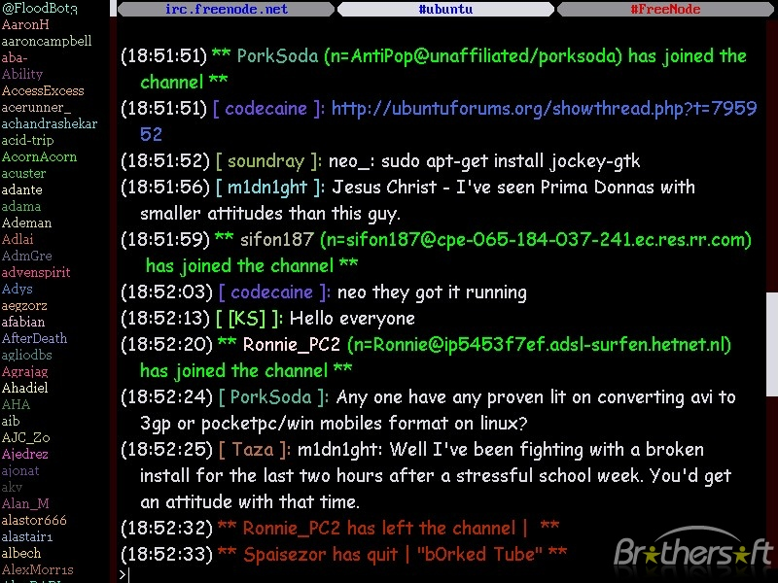

Slide 92


Slide 93
Key-Value Store

Slide 94
Key-Value Store
NoSQL

Slide 95
Key-Value Store
NoSQL
Cache Store

Slide 96
Key-Value Store
NoSQL
Cache Store
Pub/Sub Model

Slide 97
write.php
<?
// DO SOMETHING
// assume that $article_id, $author_name is assigned.
$redis = new Redis();
$redis->connect('127.0.0.1');
$redis->publish('new_article', json_encode(array(
'article_id'=>$article_id,
'author_name' => $author_name)));
$redis->close();

Slide 98
Subscribe.php
<?
function callfunc($redis, $channel, $msg){
if($channel === 'new_article'){
echo $msg;
}
exit; // Erase this line if you use WebSocket
}
$redis = new Redis();
$redis->connect('127.0.0.1');
$redis->subscribe(array('new-article'), 'callback_func');

Slide 99
Redis PUBLISH/SUBSCRIBE
Message Queue
PostgreSQL’s NOFITY/LISTEN

Slide 100
결론
Push!
Client
  (Short) Polling
    Not Real Time
  COMET
    Real time Push via HTTP request
    (Long) Polling
  WebSocket
Server
  Pub/Sub Model
    Redis
    PostgreSQL
    Message Queue

