Slide 1
Introduction to Flask
Upnl 24th workshop
kim jae chan

Slide 2
Flask

Slide 3
Python

Slide 4
Python
werkzeug based

Slide 5
Python
werkzeug based
microframework

Slide 6
Python
werkzeug based
microframework

Slide 7
Python?

Slide 8
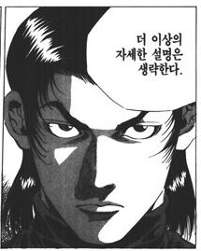

Slide 9
Guido van Rossum

Slide 10

Guido van Rossum

Slide 11
Guido van Rossum
2005-2012 Google

Slide 12
Guido van Rossum
2005-2012 Google
2013- Dropbox

Slide 13
Guido van Rossum
Script

Slide 14
Guido van Rossum
Script
Easy

Slide 15
Guido van Rossum
Script
Easy
Popular

Slide 16
def factorial(x):
return x <= 0 and 1 or factorial(x-1) * x
if __name__ == '__main__':
print factorial(100)

Slide 17
def factorial(x):
return x <= 0 and 1 or factorial(x-1) * x
if __name__ == '__main__':
print factorial(100)
def factorial(x):
return reduce(lambda x, y: x * y, range(1, x+1))
if __name__ == '__main__':
print factorial(100)

Slide 18
def factorial(x):
return x <= 0 and 1 or factorial(x-1) * x
if __name__ == '__main__':
print factorial(100)
def factorial(x):
return reduce(lambda x, y: x * y, range(1, x+1))
if __name__ == '__main__':
print factorial(100)
def factorial(x):
result = 1
for i in range(1, x+1):
result *= i
return result
if __name__ == '__main__':
print factorial(100)

Slide 19
Python
werkzeug based
microframework

Slide 20
Werkzeug
Notes:
벡ㅋ차이크 비슷하게 발음. 독일어로 ‘도구＇라는 뜻

Slide 21
One of WSGI implementation

Slide 22
WSGI?

Slide 23
Web Server Gateway Interface

Slide 24
Web Server
Python Application
Python Framework

Slide 25
Web Server
Python Application
Python Framework
Request

Slide 26
Web Server
Python Application
Python Framework
Request
Response

Slide 27
WSGI
Web Server
Python Application
Python Framework
Request
Response
Notes:
WSGI는 약속. 이걸 구현한 것 중 하나가 werkzeug

Slide 28
Python
werkzeug based
microframework

Slide 29
Microframework

Slide 30
Micro + framework

Slide 31
Micro

Slide 32
django
pip install django
django-admin.py startproject <project_name>
cd <project_name>
coding..
python manage.py runserver

Slide 33
django
pip install django
django-admin.py startproject <project_name>
cd <project_name>
coding..
python manage.py runserver
ASP.NET
Create project in Visual Studio.
Many, many files are automatically created.
But almost files are useless.
coding..
Press F5 to debug

Slide 34
Flask
pip install flask
Open vim
coding..
???
PROFIT!

Slide 35
micro != lack of feature

Slide 36
micro != lack of feature
start quickly

Slide 37
micro != lack of feature
start quickly
simple to use

Slide 38
micro != lack of feature
start quickly
simple to use
structural flexibility

Slide 39
micro != lack of feature
start quickly
simple to use
structural flexibility
extendable

Slide 40
Examples

Slide 41
app.py
from flask import Flask
app = Flask(__name__)
@app.route('/')
def index():
return u‘Hello, World!'
if __name__ == '__main__':
app.run(debug=True)

Slide 42
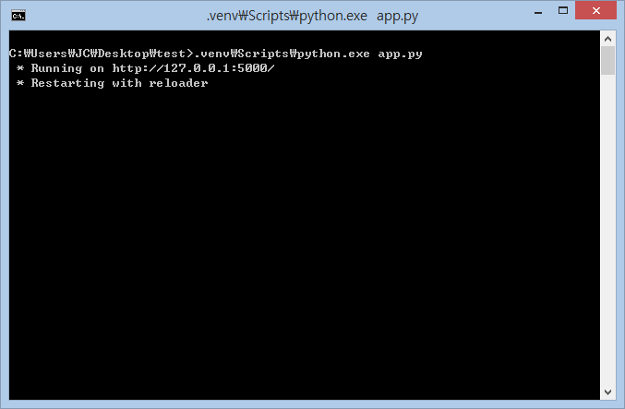

Slide 43
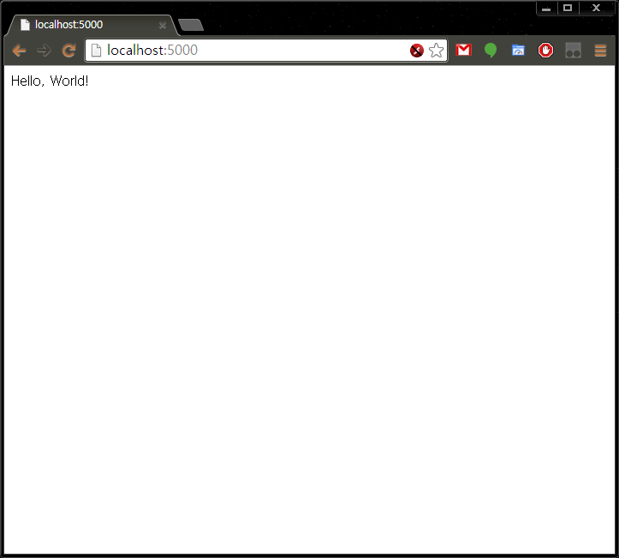

Slide 44
app.py
from flask import Flask
app = Flask(__name__)
@app.route('/')
def index():
return u'Hello, World!‘
@app.route('/<name>')
def index_name(name):
return u'Hello, ' + name
if __name__ == '__main__':
app.run(debug=True)

Slide 45


Slide 46
app.py
from flask import Flask
app = Flask(__name__)
@app.route('/')
def index():
return u'Hello, World!‘
@app.route('/<name>')
@app.route('/<name>/<int:times>')
def index_name(name, times=None):
if not times:
times = 1
return (u'Hello, ' + name + '! ') * times
if __name__ == '__main__':
app.run(debug=True)

Slide 47
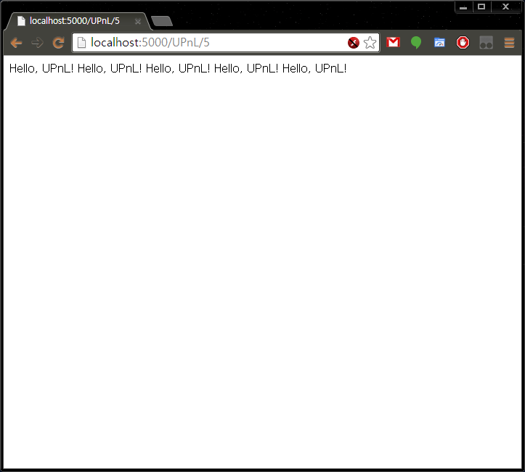

Slide 48
I want to create HTML page!

Slide 49
templates/index.html
<!doctype html>
<html>
<head>
<meta charset="utf-8" />
<title>TestPage</title>
</head>
<body>
<h1>{{ content }}<h1>
</body>
</html>

Slide 50
templates/index.html
<!doctype html>
<html>
<head>
<meta charset="utf-8" />
<title>TestPage</title>
</head>
<body>
<h1>{{ content }}<h1>
</body>
</html>
app.py
from flask import Flask, render_template
app = Flask(__name__)
@app.route('/')
def index():
return render_template('index.html',
content=u'Hello, World!')
@app.route('/<name>')
@app.route('/<name>/<int:times>')
def index_name(name, times=None):
if not times:
times = 1
content = (u'Hello, ' + name + '! ') * times
return render_template('index.html', content=content)
if __name__ == '__main__':
app.run(debug=True)

Slide 51
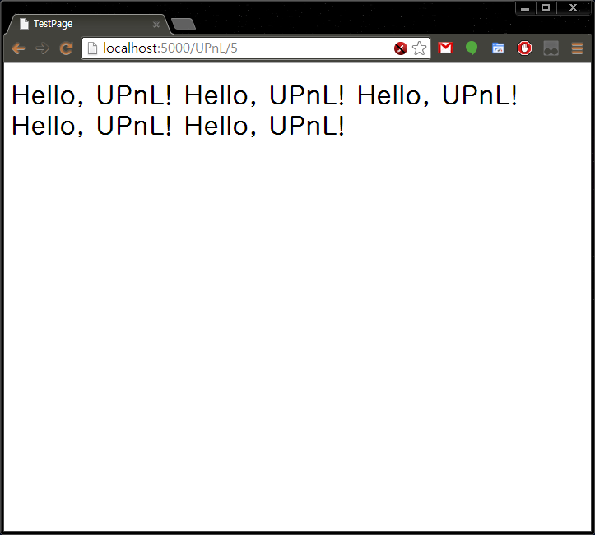

Slide 52
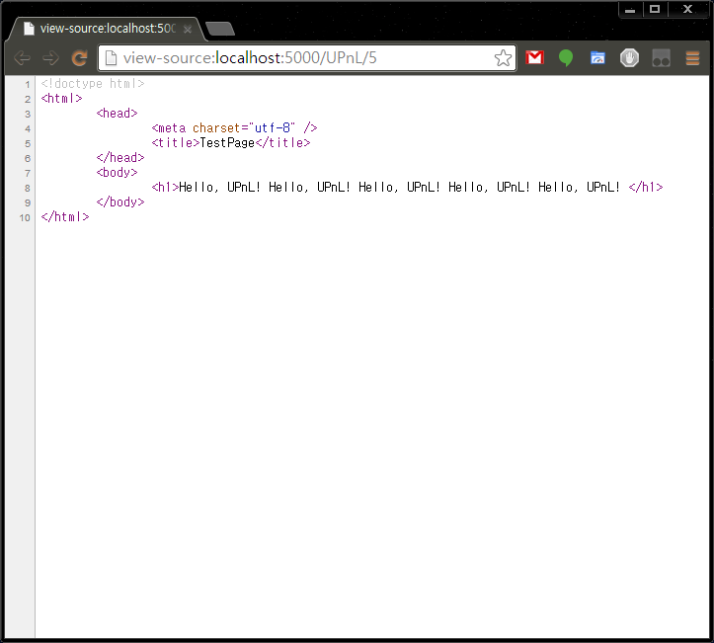

Slide 53
Conclusion

Slide 54
Web development is easy to start

Slide 55
Web development is easy to start
Flask is useful tool

Slide 56
Web development is easy to start
Flask is useful tool
Python is also good tool

Slide 57
Web development is easy to start
Flask is useful tool
Python is also good tool
Don’t be afraid of web

Slide 58
Most important thing is

Slide 59
Most important thing is
Your idea.

Slide 60
Reference
http://python.org
http://flask.pocoo.org
http://werkzeug.pocoo.org
http://wsgi.readthedocs.org

Slide 61
The End
고기가 먹고 싶어요

